Slide 1
Beerazon
Steven Freed
John sweeney
Denny sabu
Cs 336
BeerbardrinkerPlus

Slide 2
Project outline
Database
ER Diagram
Schema
Data Generation
Backend
API endpoint
Serving requests from EC2
Frontend
Deployment on EC2
Styling

Slide 3
Database – ER diagram
(here)

Slide 4
Database – Schema
(here)

Slide 5
Database – data generation
John talk about ur csvs and programs

Slide 6
Database – data generation
John talk about ur csvs and programs

Slide 7
Database – data generation
John talk about ur csvs and programs

Slide 8
Backend – api endpoint

Slide 9
Backend – serving request

Slide 10

Frontend
Utilized the extremely popular React Framework to gain experience with the MERN Stack used in the web development industry.
React Framework allowed access to a wide array of open source libraries to assist with graphing of data.
Allowed for rapid development and testing before deploying.

Slide 11
Frontend – reactstrap
To improve the visuals of our overall project, we turned first to reactstrap.
Using the reactstrap components significantly improved the style of our website, making it look modern and sleek.
Without reactstrap, we would’ve had to style each item using only CSS which would take up many hours of development time.

Slide 12
Frontend – representing data
To effectively plot our data on graphs, we turned to the massive open source libraries available for React.
The Uber-VIS library suited our needs nicely.
Ran into some problems regarding poor documentation.
Problems aside, configuring the graphs and populating them was fairly straight forward.

Slide 13
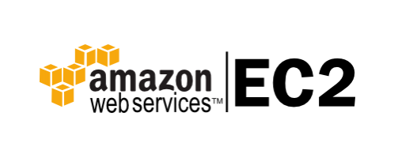
deployment
Tried to deploy frontend on Amazon S3 and backend on Amazon EC2, however, we ran into major problems allowing permissions for cross-server communications.
After much trial and error, we decided to host the frontend on EC2 at port 3000 and the backend at port 5000.
This allowed for a seamless transfer of information, and error free.

